Slide 1
Customer Sales Analysis Using Power BI
A Data-Driven Approach to Understanding Sales Trends

Slide 2
INTRODUCTION
DATASET OVERVIEW:
Key Fields
Date (Transaction date)
Transaction ID (Unique sale identifier)
Customer ID (Unique customer identifier)
Gender (Male/Female)
Age (Customer age)
Product Category (Type of product purchased)
Quantity (Number of units purchased)
Price per Unit (Cost per unit)
Total Amount (Total sale value)
Project Objectives
Analyze customer purchasing behavior based on age and gender.
Identify sales trends.
Determine top-performing product categories.
Provide business recommendations for optimizing sales strategies.

Slide 3
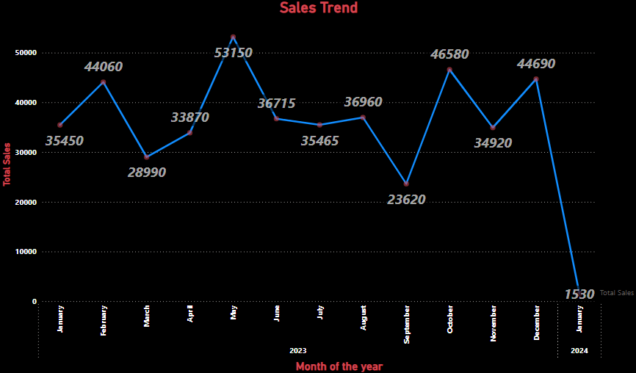
Monthly Sales Trend
May 2023 recorded the highest sales, likely due to mid-year promotions, increased consumer spending, or special events.
January 2024 had the lowest sales, possibly due to post-holiday financial constraints, where customers reduced spending after December's peak shopping season.

Slide 4
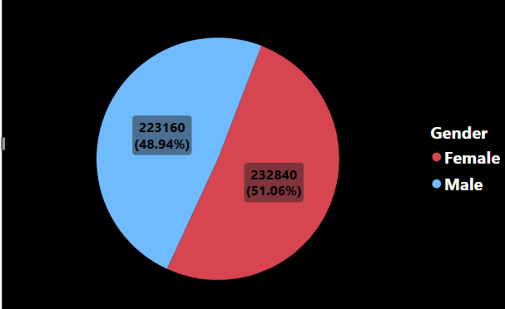
Sales By Gender
The sales distribution is almost equal between genders, with Females contributing slightly more (51%) compared to Males (49%).This suggests no significant gender-based dominance in purchasing, but slight variations might exist depending on specific product categories.

Slide 5
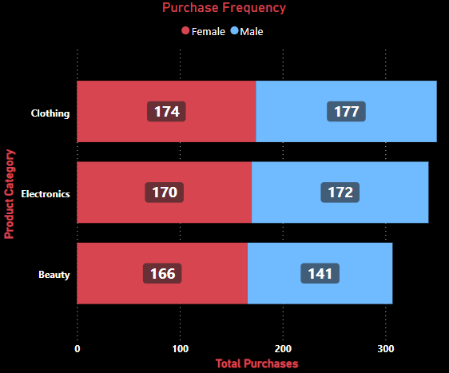
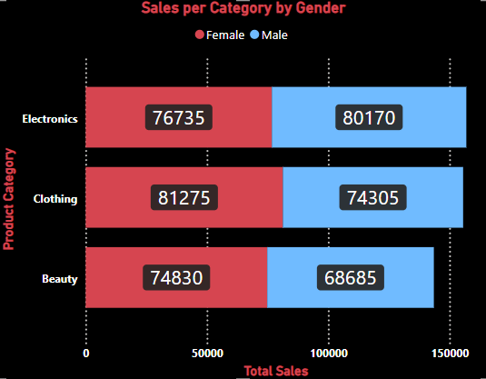
•For Clothing: Leverage frequent purchasing habits by offering loyalty programs, discounts, or new arrivals marketing to encourage repeat sales. • For Electronics: Focus on high-value promotions, installment payment options, or bundling offers to maximize revenue from fewer purchases. • For Gender-Specific Strategies: Use personalized marketing—target women with fashion deals and men with tech-related offers.
Clothing is the most frequently purchased category, indicating high customer engagement. Women buy more clothing than men. Frequent purchases may be driven by fashion trends, seasonal changes, or promotions.
Electronics generate the most revenue, despite being purchased less frequently. Men spend more on electronics purchases might be less frequent but of higher value, such as laptops, phones, or appliances.

Slide 6
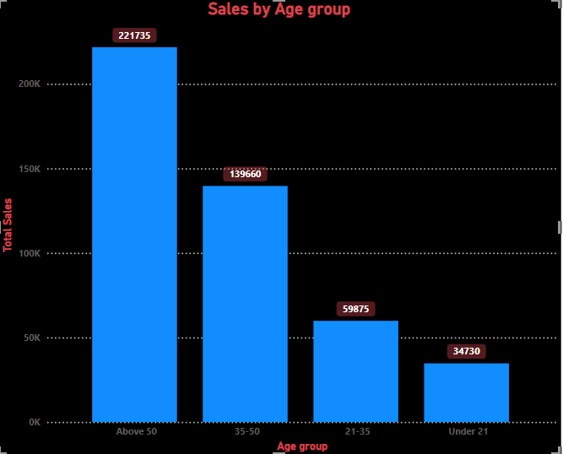
Sales by Age Groups
The age group over 50 contributes the most to total sales, indicating that older customers have a higher purchasing power
The under 21 age group has the lowest sales hence their limited financial independence and lower purchasing power

Slide 7
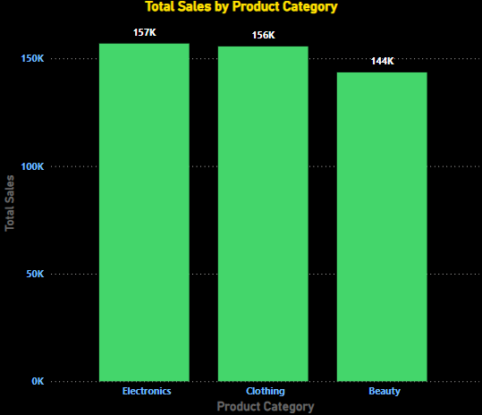
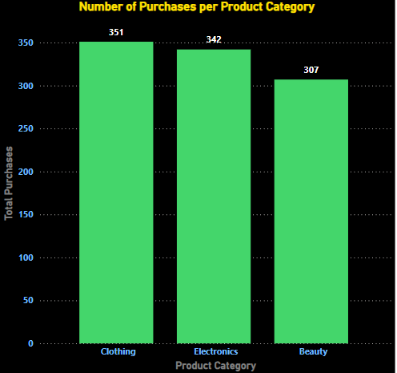
Sales by Product Category
Clothing has the highest number of purchases but lower total sales than electronics suggesting that clothing items are lower in price but are bought most frequently
Electronics generate the highest total sales indicating that it consists of higher-priced items, leading to higher revenue per transaction

Slide 8
Conclusions & Recommendations
Key Findings
Gender and age significantly impact purchasing behavior.
The over 50 age group contributes the most to total sales, highlighting their stronger purchasing power.
Electronics generate the highest revenue, while clothing sees more frequent purchases but lower total sales.
Sales peak in May 2023, possibly due to mid-year promotions or events, and drop in January 2024, likely due to post-holiday financial constraints.
Business Recommendations
Targeted marketing campaigns focusing on high-spending demographics, especially older customers.
Stock optimization by ensuring availability of high-demand products during peak seasons.
Promotions and discounts to boost sales in traditionally low periods like January.
Enhancing customer engagement through loyalty programs and personalized recommendations based on spending habits.

